Slide 1
CREDIT CARD DEFAULT
Classification Prediction
Presentation to ABC Company Data Science Team by Mary Donovan Martello

Slide 2

Assignment/Results/Next Steps
Project Assignment: Design a predictive binary classification model to predict whether ABC Company’s credit card account holders will default on their payments in the next month.
Results: The Gradient Boosting Classification (Recall of 69.50%) and Artificial Neural Network (Recall of 68.61%) models are viable classification models to predict if ABC Company’s credit card account holders will default in the next month.
Next Steps: (1) improve models, (2) try different approaches to imbalanced target, (3) identify contributing factors and (4) prepare deployment plan.

Slide 3
Following CRISP-DM Stages
Data Understanding
Data Preparation
Modeling
Evaluation

Slide 4
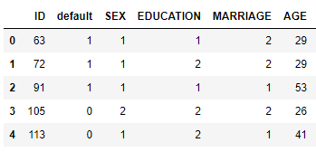
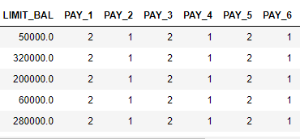
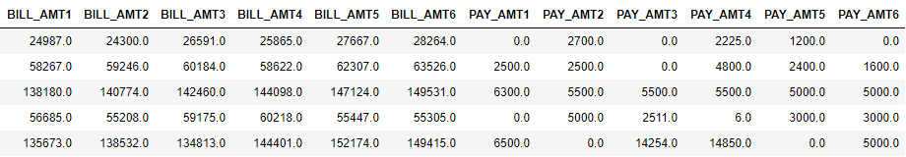
Dataset: ABC Company account information
Label and Demographic Features
Quantitative Features
More Quantitative Features

Slide 5
Data Understanding: Variable Significance
The target variable is the default variable. 0 = Non-default (78%) and 1 = Default (22%)
High
Limit Balance
6 Pay variables (repayment status)
Medium
6 Bill amount variables
6 Payment variables
Low
Gender
Education
Marriage
Age

Slide 6
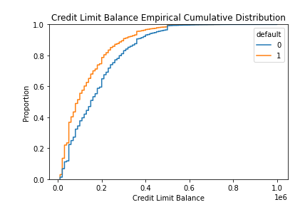
Limit Balance: Distinction between Default / Non-Default
Empirical Cumulative Distribution

Slide 7
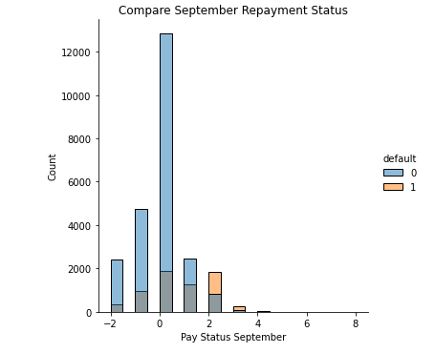
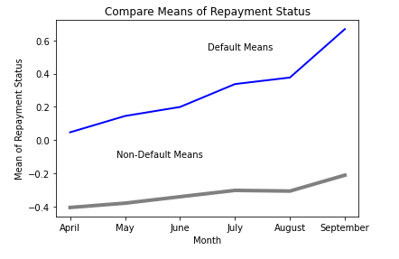
Repayment Status: Distinction between Default / Non-Default
Bar Chart Comparing Defaults and Non-Defaults

Slide 8
Feature Selection
Principal Component Analysis for multicollinearity issue from repeating variables over 6 months
ANOVA and feature importance techniques from logistic regression, decision tree classifier, random forest classifier and XGBoost classifier models
Demographic variables were not important
PCA components were important

Slide 9
Modeling
Binary Classification Models tested:
Logistic Regression
LASSO Logistic Regression
Gradient Boosting Classifier
Random Forest
Artificial Neural Network (ANN)
Methodology for the 4 non-neural network models
Phase 1: All features / GridSearch / Stratified K-fold Cross-validation
Phase 2: Best subset of features / GridSearch / Stratified K-fold Cross-validation
Phase 3: Address imbalance in the target variable
Predicted probabilities for positive outcome based on best classification threshold
Methodology for Sequential ANN
Test different epochs and batch sizes with validation data
Address target imbalance by weighting the target classes

Slide 10
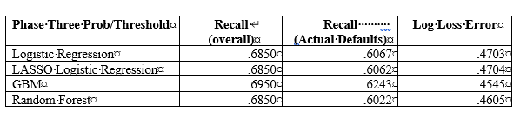
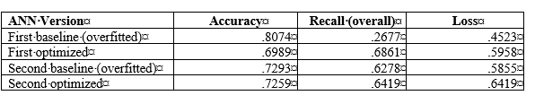
Evaluation
The Phase 3 models of the GBC, Logistic Regression and Random Forest models were evaluated on Recall and Log Loss Error:
The Artificial Neural Networks were evaluated on Recall and Binary Crossentropy Loss:

Slide 11
Conclusion / Next Steps
Conclusion:
The neural network model and the Gradient Boosting model are viable and useful models for predicting credit card defaults. The Logistic Regression and Random Forests models performed nearly as well. The models are viable but we will need additional tuning of hyperparameters and perhaps a different approach to the imbalanced target variable.
Next Steps:
(1) Improve models, (2) try different approaches to imbalanced target, (3) identify contributing factors and (4) prepare deployment plan.

